Slide 1
Modern Cookbook Development
Nathen Harvey | @nathenharvey

Slide 2
Creating Cookbooks
knife
berkshelf
chef

Slide 3
knife cookbook create my_cookbook
├── CHANGELOG.md
├── README.md
├── attributes
├── definitions
├── files
│ └── default
├── libraries
├── metadata.rb
├── providers
├── recipes
│ └── default.rb
├── resources
└── templates
└── default
10 directories, 4 files

Slide 4
berks cookbook my_cookbook
├── .gitignore
├── .kitchen.yml
├── Berksfile
├── CHANGELOG.md
├── Gemfile
├── LICENSE
├── README.md
├── Thorfile
├── Vagrantfile
├── attributes
├── chefignore
├── files
│ └── default
├── libraries
├── metadata.rb
├── providers
├── recipes
│ └── default.rb
├── resources
├── templates
│ └── default
└── test
└── integration
└── default
12 directories, 12 files

Slide 5
chef generate cookbook my_cookbook (0.10.0)
├── .gitignore
├── .kitchen.yml
├── Berksfile
├── README.md
├── chefignore
├── metadata.rb
├── recipes
│ └── default.rb
├── spec
│ ├── spec_helper.rb
│ └── unit
│ └── recipes
│ └── default_spec.rb
└── test
└── integration
├── default
│ └── serverspec
│ └── default_spec.rb
└── helpers
└── serverspec
└── spec_helper.rb
10 directories, 11 files

Slide 6
kitchen list
0.10.0
Instance Driver Provisioner Verifier Transport Last Action
default-ubuntu-1404 Vagrant ChefZero Busser Ssh <Not Created>
default-centos-71 Vagrant ChefZero Busser Ssh <Not Created>

Slide 7
chef generate cookbook my_cookbook (0.19.6)
├── .delivery
│ ├── build_cookbook
│ ├── config.json
│ └── project.toml
├── .gitignore
├── .kitchen.yml
├── Berksfile
├── README.md
├── chefignore
├── metadata.rb
├── recipes
│ └── default.rb
├── spec
│ ├── spec_helper.rb
│ └── unit
│ └── recipes
│ └── default_spec.rb
└── test
└── recipes
└── default_test.rb
17 directories, 33 files

Slide 8
kitchen list
0.19.6
Instance Driver Provisioner Verifier Transport Last Action
default-ubuntu-1604 Vagrant ChefZero Inspec Ssh <Not Created>
default-centos-72 Vagrant ChefZero Inspec Ssh <Not Created>

Slide 9
kitchen list
0.10.0
Instance Driver Provisioner Verifier Transport Last Action
default-ubuntu-1404 Vagrant ChefZero Busser Ssh <Not Created>
default-centos-71 Vagrant ChefZero Busser Ssh <Not Created>
0.19.6
Instance Driver Provisioner Verifier Transport Last Action
default-ubuntu-1604 Vagrant ChefZero Inspec Ssh <Not Created>
default-centos-72 Vagrant ChefZero Inspec Ssh <Not Created>

Slide 10
kitchen list
0.10.0
Instance Driver Provisioner Verifier Transport Last Action
default-ubuntu-1404 Vagrant ChefZero Busser Ssh <Not Created>
default-centos-71 Vagrant ChefZero Busser Ssh <Not Created>
0.19.6
Instance Driver Provisioner Verifier Transport Last Action
default-ubuntu-1604 Vagrant ChefZero Inspec Ssh <Not Created>
default-centos-72 Vagrant ChefZero Inspec Ssh <Not Created>

Slide 11
kitchen list
0.10.0
Instance Driver Provisioner Verifier Transport Last Action
default-ubuntu-1404 Vagrant ChefZero Busser Ssh <Not Created>
default-centos-71 Vagrant ChefZero Busser Ssh <Not Created>
0.19.6
Instance Driver Provisioner Verifier Transport Last Action
default-ubuntu-1604 Vagrant ChefZero Inspec Ssh <Not Created>
default-centos-72 Vagrant ChefZero Inspec Ssh <Not Created>

Slide 12
Testing Your New Cookbook
cookstyle
https://github.com/chef/cookstyle
Version pinned rubocop and reasonable defaults for Chef Cookbooks
Notes:
Demo
– rubocop in new cookbook – see failures
- cookstyle – no failures

Slide 13
Testing Your New Cookbook
cookstyle
https://github.com/chef/cookstyle
Version pinned rubocop and reasonable defaults for Chef Cookbooks
Foodcritic
Notes:
Demo
– rubocop in new cookbook – see failures
- cookstyle – no failures
Demo
foodcritic .
echo $?
foodcritic . –f any
Exclude test, exlucde the two supermarket urls

Slide 14
Testing Your New Cookbook
cookstyle
https://github.com/chef/cookstyle
Version pinned rubocop and reasonable defaults for Chef Cookbooks
Foodcritic
Chefspec
Notes:
Demo
– rubocop in new cookbook – see failures
- cookstyle – no failures
Demo
foodcritic .
echo $?
foodcritic . –f any
Exclude test, exlucde the two supermarket urls

Slide 15
Testing Your New Cookbook
cookstyle
https://github.com/chef/cookstyle
Version pinned rubocop and reasonable defaults for Chef Cookbooks
Foodcritic
Chefspec
Test Kitchen
Notes:
Demo
– rubocop in new cookbook – see failures
- cookstyle – no failures
Demo
foodcritic .
echo $?
foodcritic . –f any
Exclude test, exlucde the two supermarket urls

Slide 16




Workflow
Compliance
Visibility
Infrastructure Automation
Application Automation
Compliance Automation
Notes:
This is Chef

Slide 17
Delivery Prototype for Local Phases Execution
delivery local syntax
delivery local lint
delivery local unit
delivery local provision
delivery local deploy
delivery local smoke
delivery local cleanup

Slide 18
New Chef Resources
apt_update
apt_repository
yum_repository
systemd_unit
chocolatey_package
cab_package
launchd
osx_profile
ksh

Slide 19
New Ohai Plugins
shard
machineid
hostnamectl
shells
hardware
time
fips
scala
sessions
packages

Slide 20


Slide 21
Custom Resources

Slide 22
Custom resources are reusable Chef resources you define within your cookbooks that make it easy to automate repetitive tasks within your organization’s cookbooks

Slide 23
Custom resources build on the foundations of Lightweight Resource Providers (LWRPs) with powerful new functionality and a simpler DSL

Slide 24
Custom Resources
Introduced in Chef 12.5
Compatible with Chef 12.1+ using the compat_resource cookbook
Built on years of experience with LWRPs

Slide 25
Improvements over LWRPs
Everything in a single file
Greatly simplified DSL
New DSL for supporting multiple platforms / platform versions
“Just works” out-of-the-box

Slide 26
resources/myapp.rb file:
actions :create
default_action :create
attribute :name, kind_of: String, name_attribute: true
attribute :app_name, kind_of: String, default: 'default_app'
providers/myapp.rb file:
use_inline_resources
def whyrun_supported?
true
end
action :create do
template '/some/web/app/config' do
owner 'root'
group 'root'
variables(app_name: new_resource.app_name)
notifies :restart, 'service[apache2]'
end
service 'apache2' do
action :nothing
end
end

Slide 27
resources/myapp.rb file:
actions :create
default_action :create
attribute :name, kind_of: String, name_attribute: true
attribute :app_name, kind_of: String, default: 'default_app'
providers/myapp.rb file:
use_inline_resources
def whyrun_supported?
true
end
action :create do
template '/some/web/app/config' do
owner 'root'
group 'root'
variables(app_name: new_resource.app_name)
notifies :restart, 'service[apache2]'
end
service 'apache2' do
action :nothing
end
end

Slide 28
resources/myapp.rb file:
actions :create
default_action :create
attribute :name, kind_of: String, name_attribute: true
attribute :app_name, kind_of: String, default: 'default_app'
providers/myapp.rb file:
use_inline_resources
def whyrun_supported?
true
end
action :create do
template '/some/web/app/config' do
owner 'root'
group 'root'
variables(app_name: new_resource.app_name)
notifies :restart, 'service[apache2]'
end
service 'apache2' do
action :nothing
end
end
resources/myapp.rb file:
property :name, String, name_attribute: true
property :app_name, String, default: 'default_app'
action :create do
template '/some/web/app/config' do
owner 'root'
group 'root'
variables(app_name: new_resource.app_name)
notifies :restart, 'service[apache2]'
end
end

Slide 29
Chef Solo

Slide 30
Chef Solo now uses the same technology as Chef Client Local Mode

Slide 31
Editing and Deleting Resources

Slide 32
Chef Rewind extension is no longer required - Chef 12.10 and later.

Slide 33
Delete
chef_gem 'chef-rewind'
require 'chef/rewind'
unwind 'user[postgres]'

Slide 34
Delete
chef_gem 'chef-rewind'
require 'chef/rewind'
unwind 'user[postgres]'
delete_resource(:user,'postgres')

Slide 35
Edit
chef_gem 'chef-rewind'
require 'chef/rewind'
rewind 'user[postgres]' do
home '/var/lib/postgres'
end

Slide 36
Edit
chef_gem 'chef-rewind'
require 'chef/rewind'
rewind 'user[postgres]' do
home '/var/lib/postgres'
end
edit_resource!(:user,'postgres') do
home '/var/lib/postgres'
end

Slide 37

Notes:
https://www.flickr.com/photos/nnova/2043992972

Slide 38
Built-in Apt & Yum Resources

Slide 39
metadata.rb
name 'my_cookbook'
maintainer 'Me'
maintainer_email 'me@gmail.com'
license 'Apache 2.0'
version '1.0.0'
depends 'apt'
depends 'yum'

Slide 40
Update the Debian / Ubuntu Package Cache
include_recipe 'apt::default'

Slide 41
metadata.rb
name 'my_cookbook'
maintainer 'Me'
maintainer_email 'me@gmail.com'
license 'Apache 2.0'
version '1.0.0'
depends 'apt'
depends 'yum'

Slide 42
Update the Debian / Ubuntu Package Cache
include_recipe 'apt::default'
apt_update 'update please'

Slide 43
Package Repositories
apt_repository 'OurCo' do
uri 'http://artifacts.ourco.org/ubuntu/something'
action :true
components ['main']
end
yum_repository 'OurCo' do
description 'OurCo Yum repository'
mirrorlist 'http://artifacts.ourco.org/mirrorlist?repo=oc-6&arch=$basearch'
gpgkey 'http://artifacts.ourco.org/pub/yum/RPM-GPG-KEY-OURCO-6'
action :create
end

Slide 44
Multi-package

Slide 45
Multiple Packages
Old Way
%w{ httpd jenkins tmux }.each do |pkg|
package pkg
end

Slide 46
Multiple Packages
New Way
package %w{ httpd jenkins tmux }
Old Way
%w{ httpd jenkins tmux }.each do |pkg|
package pkg
end

Slide 47
Cookbook Gem Dependencies

Slide 48
Old Way
Recipe
chef_gem 'docker' do
compile_time true
end
Library
begin
require 'docker'
rescue LoadError
puts 'waiting to load Docker'
end

Slide 49
New Way (12.9.1)
metadata.rb
gem 'docker'
Library
require 'docker'

Slide 50
Windows Improvements

Slide 51
New Resources
chocolatey_package (Chef 12.7.0)
cab_package (Chef 12.15.19)

Slide 52
Newly Built-in Windows Resources
reboot
batch
registry
package

Slide 53
Cookbook Testing with Travis & AppVeyor
Let’s look at the code
https://github.com/chef-cookbooks/windows/blob/master/.travis.yml
https://github.com/chef-cookbooks/windows/blob/master/appveyor.yml
https://github.com/chef-cookbooks/windows/blob/master/Rakefile

Slide 54
More Cookbook Testing with Travis
https://github.com/chef-cookbooks/activemq/blob/master/.travis.yml
https://travis-ci.org/chef-cookbooks/activemq
https://github.com/chef-cookbooks/activemq/blob/master/.kitchen.docker.yml
https://github.com/someara/kitchen-dokken

Slide 55



Slide 56
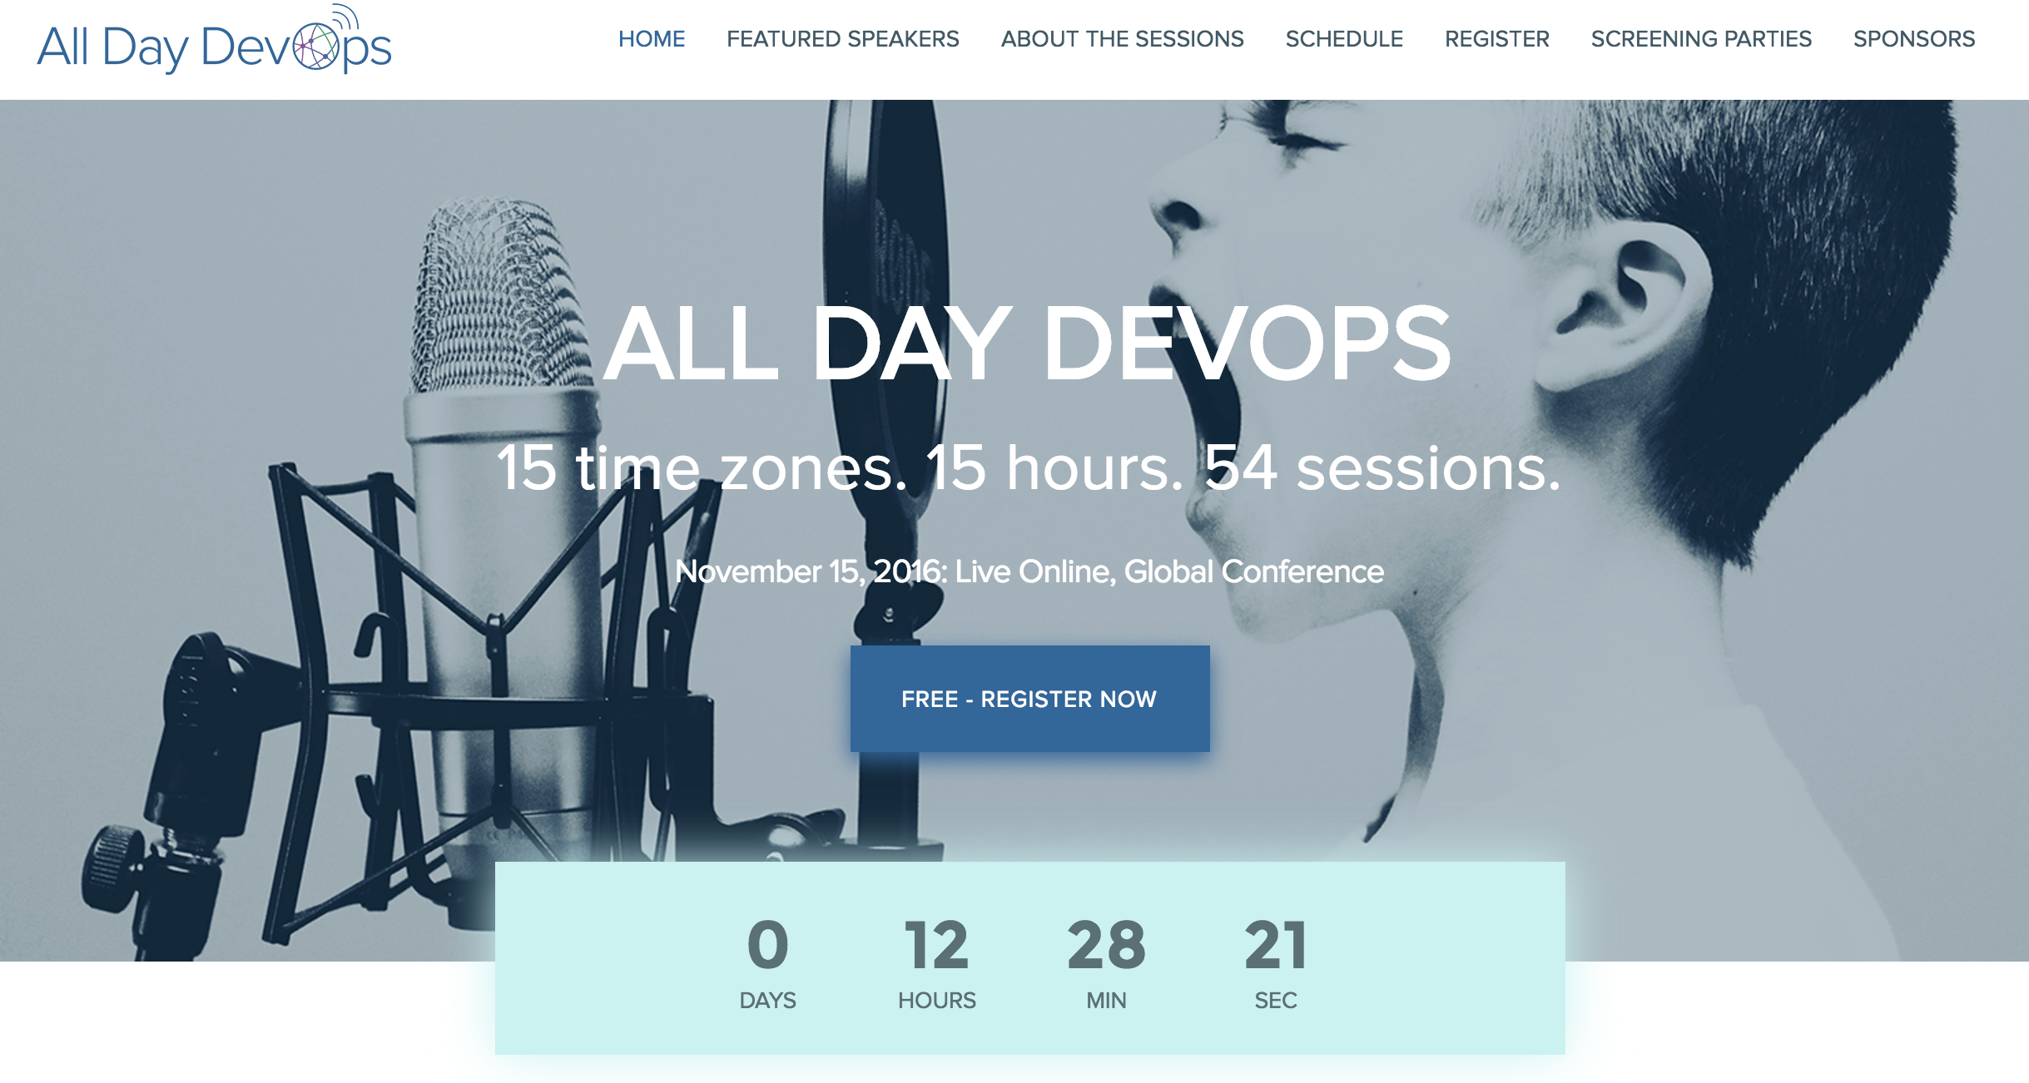

Slide 57
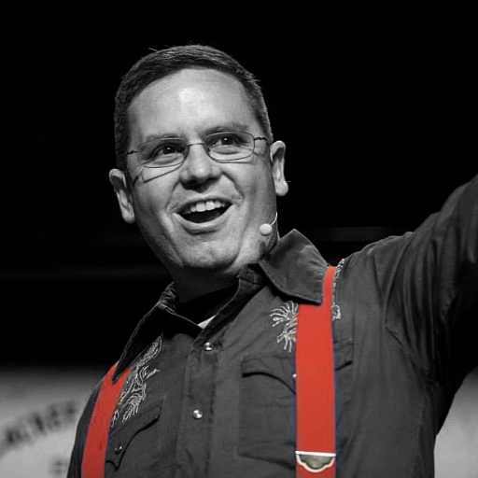

Nathen Harvey
VP, Community Development at Chef
Co-host of the Food Fight Show Podcast
Occasional farmer – http://ei.chef.io
Love eggs – http://eggs.chef.io
#hugops – http://hugops.chef.io
@nathenharvey
nharvey@chef.io

